Slide 1
Searching and Sorting
Dr. Maher Mneimneh

Slide 2
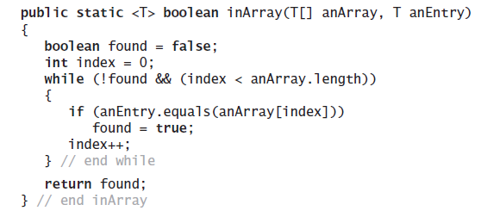
Iterative Sequential Search of an Unsorted Array

Slide 3
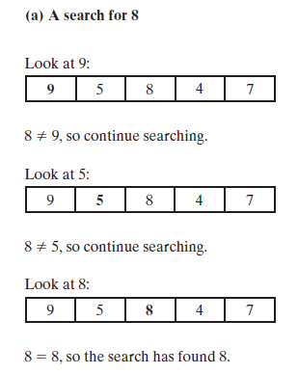
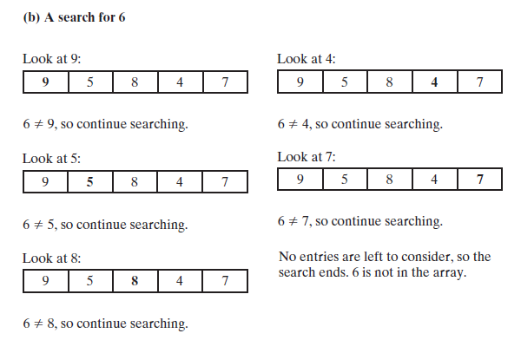
Iterative Sequential Search of an Unsorted Array

Slide 4
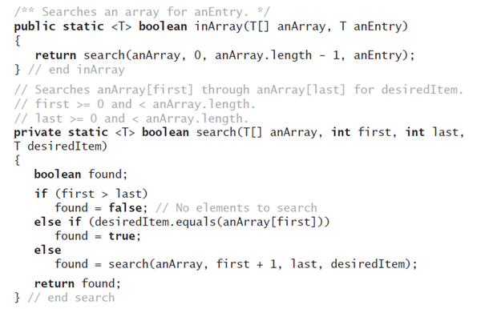
Recursive Sequential Search of an Unsorted Array

Slide 5
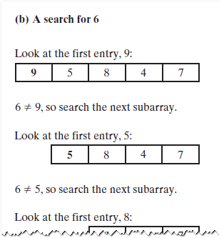
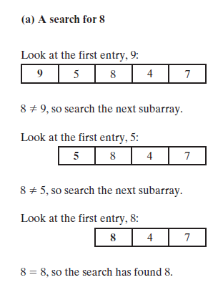
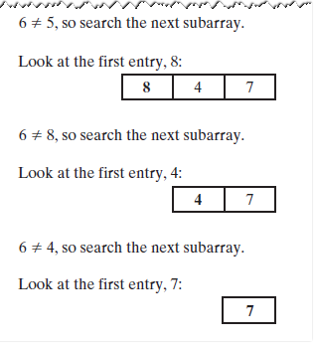
Recursive Sequential Search of an Unsorted Array

Slide 6
Efficiency of a Sequential Search of an Array
The time efficiency of a sequential search of an array.
Best case O(1)
Worst case: O(n)

Slide 7

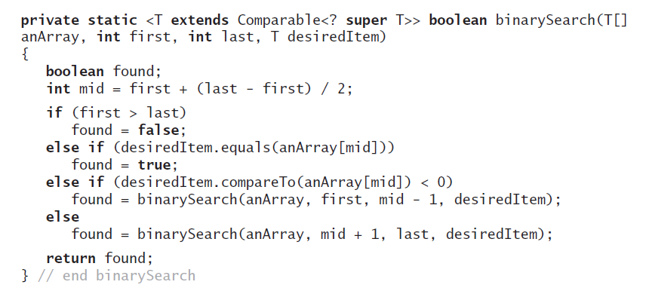
Binary Search of a Sorted Array
public static <T extends Comparable<? super T>> boolean inArray(T[] anArray, T anEntry)
{
return binarySearch(anArray, 0, anArray.length - 1, anEntry);
}

Slide 8
public static bool binarySearch(int[] a, int item) {
int first = 0;
int last = a.length – 1;
while( first <= last) {
int mid = (first + last)/2;
if(a[mid] == item) return true;
else if (a[mid] < item) first = mid + 1;
else last = mid – 1;
}
return false;
}

Slide 9
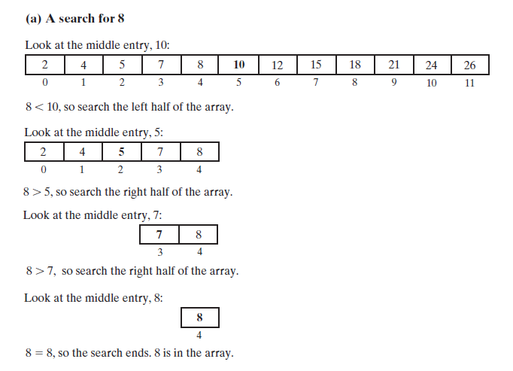
Binary Search of a Sorted Array

Slide 10
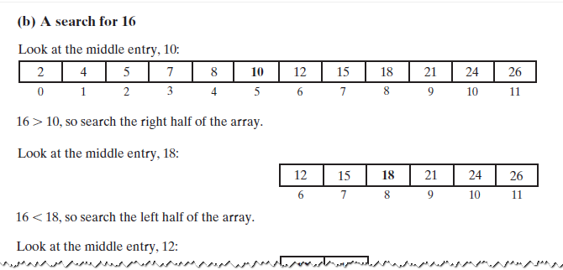
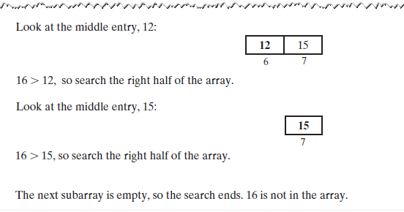
Binary Search of a Sorted Array

Slide 11
Efficiency of a Binary Search of an Array
The time efficiency of a binary search of an array
Best case: O(1)
Worst case: O(log n)

Slide 12
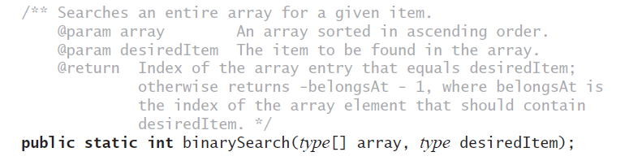
Java Class Library: The Method binarySearch

Slide 13
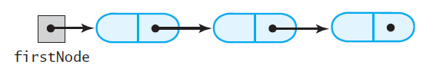
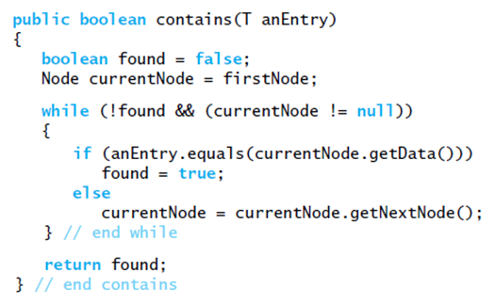
Iterative Sequential Search of an Unsorted Chain

Slide 14
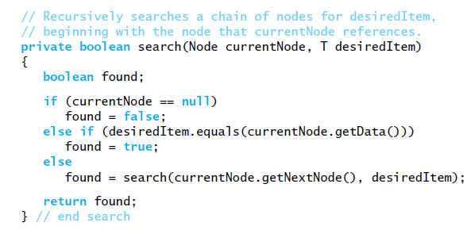
Recursive Sequential Search of an Unsorted Chain

Slide 15
Efficiency of a Sequential Search of a Chain
The time efficiency of a sequential search of a chain of linked nodes
Best case: O(1)
Worst case: O(n)

Slide 16
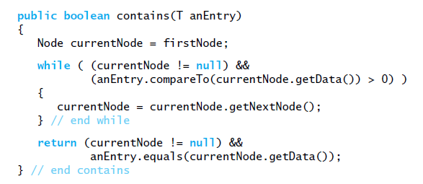
Searching a Sorted Chain

Slide 17
Binary Search of a Sorted Chain
To find the middle of the chain you must traverse the whole chain
Then must traverse one of the halves to find the middle of that half
Conclusion
Hard to implement
Less efficient than sequential search

Slide 18
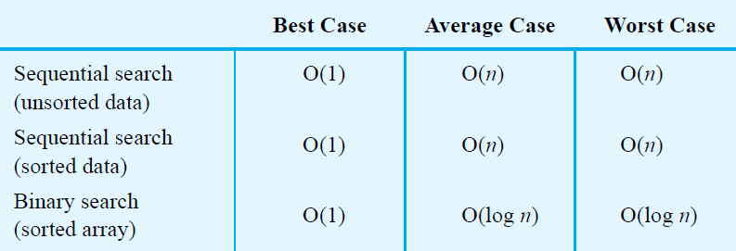
Choosing between Sequential Search and Binary Search

Slide 19
Choosing between Iterative Search and Recursive Search
Can save some time and space by using iterative version of a search
Using recursion will not require much additional space for the recursive calls
Coding binary search recursively is somewhat easier

Slide 20
Sorting Algorithms and Their Efficiency
Sorting
A process that organizes a collection of data into either ascending or descending order
Categories of sorting algorithms
An internal sort
Requires that the collection of data fit entirely in the computer’s main memory
An external sort
The collection of data will not fit in the computer’s main memory all at once but must reside in secondary storage
Data items to be sorted can be
Integers
Character strings
Objects
Sort key
The part of a record that determines the sorted order of the entire record within a collection of records
E.g: you can sort class Person by name, age, or zip code

Slide 21
Applications of Sorting
Given n (in an array p) points on the real axis, find the 2 points that are closest/furthest to/from each other
Given an array of n values, find the value that occurs most frequently
Given an array of n values, find the number of distinct values
Given an array of n values, find a pair of values whose sum is closest to 0
p[2]
p[4]
p[1]
p[3]
p[0]

Slide 22
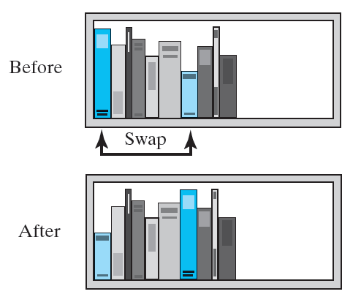
Selection Sort
Selection sort
Strategy 1
Select the smallest item and put in correct place
Select next smallest item and put it in its correct place, repeat

Slide 23
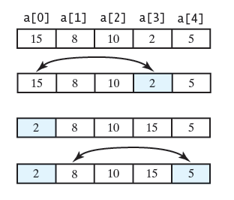
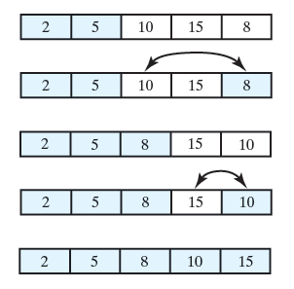
Selection Sort
Selection sort
Strategy 1 example:

Slide 24
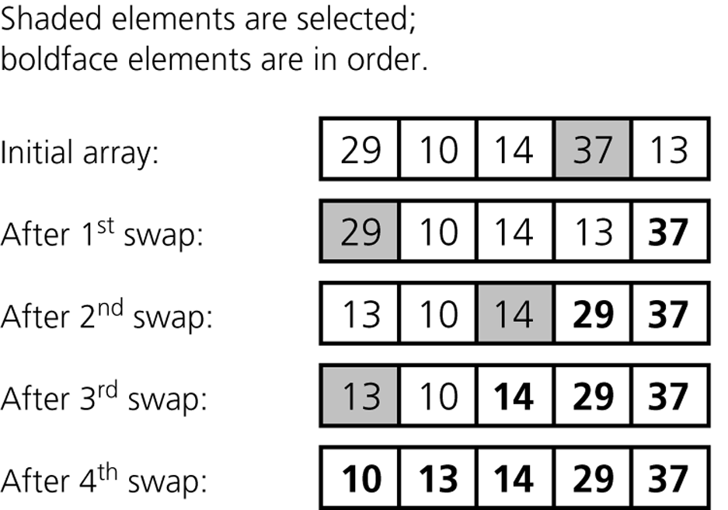
Selection Sort
Selection sort
Strategy 2
Select the largest item and put it in its correct place
Select the next largest item and put it in its correct place, etc.

Slide 25
Selection Sort : Strategy 1 Implementation
public static <T extends Comparable<? super T>> void selectionSort(T[] a, int n) {
for (int index = 0; index < n - 1; index++){
int indexOfSmallest = indexOfSmallest(a, index, n - 1);
T temp = a[index];
a[index] = a[indexOfSmallest];
a[indexOfSmallest] = temp;
//Invariant: a[0] <= a[1] <= . . . <= a[index] <= all other a[i]
} // end for
}
private static <T extends Comparable<? super T>>
int indexOfSmallest(T[] a, int first, int last) {
T min = a[first];
int indexOfMin = first;
for (int index = first + 1; index <= last; index++) {
if (a[index].compareTo(min) < 0){
min = a[index];
indexOfMin = index;
}
}
return indexOfMin;
}

Slide 26
Selection Sort : Strategy 1 Implementation
public static void main(String [] args) {
Integer [] a = { 15, 8 , 10 , 2, 5 };
selectionSort(a, a.length);
System.out.println("a = " + Arrays.toString(a));
}
Output:
a = [2, 5, 8, 10, 15]

Slide 27
Selection Sort : Worst case runtime
public static <T extends Comparable<? super T>> void selectionSort(T[] a, int n) {
for (int index = 0; index < n - 1; index++){
int indexOfSmallest = indexOfSmallest(a, index, n - 1);
T temp = a[index];
a[index] = a[indexOfSmallest];
a[indexOfSmallest] = temp;
}
}
private static <T extends Comparable<? super T>>
int indexOfSmallest(T[] a, int first, int last) {
T min = a[first];
int indexOfMin = first;
for (int index = first + 1; index <= last; index++) {
if (a[index].compareTo(min) < 0){
min = a[index];
indexOfMin = index;
}
}
return indexOfMin;
}
 | Times
 | n-1
 | 3+4(n-1)+ … + 3+4(1)
 | n-1
 | n-1
 | n-1
 | 0
 | 0
 | Total:
 | Times
 | 1
 | 1
 | last - first
 | last - first
 | last - first
 | last - first
 | 0
 | 0
 | 1 Total: 3 + 4(last-first)

Slide 28
Selection Sort
What input will give worst performance?
Is the operation of exchanging items expensive?
No since we are exchanging the references and not copying the data in an object
Analysis
for loop: executes n times
indexOfSmallest is called n times
First time it finds smallest among n, second time finds smallest among n-1 , ….
Total cost is n -1 + n – 2 + n – 3 + … + 2 = n(n-1)/2 - 1
3n exchanges take place at end of for loop
Total is n(n-1)/2 + 3(n-1) which is O(n²)
Advantage of selection sort
It does not depend on the initial arrangement of the data
Disadvantage of selection sort
It is only appropriate for small n
What is the best case performance? on what input?

Slide 29
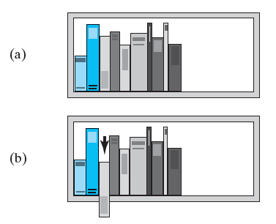
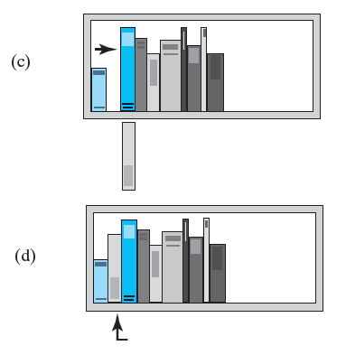
Insertion Sort
Intuition:
When book found shorter than book to left
Remove shorter book (step b)
Slide taller books to right one at a time (step c)
Insert shorter book in empty spot (step d)

Slide 30
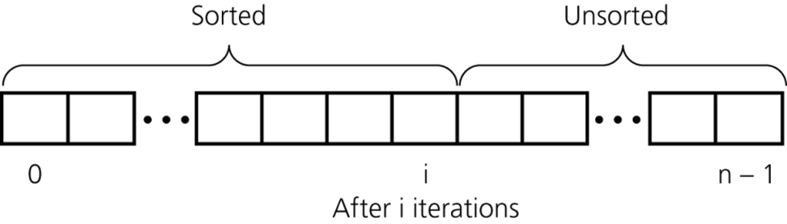
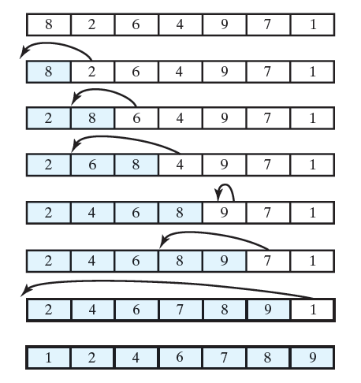
Insertion Sort
Using this strategy, we are guaranteed to have a sorted region as shown below
Example:

Slide 31
Insertion Sort: Algorithm
public static <T extends Comparable<? super T>>
void insertionSort(T[] a, int n) {
for(int unsorted = 1; unsorted < n; ++unsorted) {
T item = a[unsorted];
int loc = unsorted;
while(loc > 0 && a[loc-1].compareTo(item) > 0) {
a[loc] = a[loc-1];
--loc;
}
a[loc] = item;
}
}
public static void main(String [] args) {
Integer [] a = { 15, 8 , 10 , 2, 5 };
insertionSort(a, a.length);
System.out.println("a = " + Arrays.toString(a));
}
Output:
a = [2, 5, 8, 10, 15]

Slide 32
Insertion Sort: Analysis
What is the worst input to the algorithm?
Array that is in reverse order
public static <T extends Comparable<? super T>>
void insertionSort(T[] a, int n) {
for(int unsorted = 1; unsorted < n; ++unsorted) {
T item = a[unsorted];
int loc = unsorted;
while(loc > 0 && a[loc-1].compareTo(item) > 0) {
a[loc] = a[loc-1];
--loc;
}
a[loc] = item;
}
}
 | Cost | Times
 | c1 | n-1
 | c2 | n-1
 | c3 | n-1
 | c4 | 1+2+..n-1
 | c5 | 1+2+..n-1
 | c6 | 1+2+..n-1
 | 0 | 0
 | c7 | n-1
 | 0 | 0
 | 0 | 0
Running time=c1(n-1) + c2(n-1) + c3(n-1) + c4(n(n-1/2) + c5(n(n-1)/2) + c6(n(n-1)/2) + c7(n-1)
=(c4/2+c5/2+c6/2)n² + (c1+c2+c3-c4/2-c5/2-c6/2+c7)n –(c1+c2+c3+c7)
Running time is O(n²)
Key Observation: changing cost of operation per line to a constant (instead of 1) doesn’t change big O result

Slide 33
Insertion Sort: Best-case Analysis
What is the best input to the algorithm?
Array that is already sorted
public static <T extends Comparable<? super T>>
void insertionSort(T[] a, int n) {
for(int unsorted = 1; unsorted < n; ++unsorted) {
T item = a[unsorted];
int loc = unsorted;
while(loc > 0 && a[loc-1].compareTo(item) > 0) {
a[loc] = a[loc-1];
--loc;
}
a[loc] = item;
}
}
 | Cost | Times
 | c1 | n-1
 | c2 | n-1
 | c3 | n-1
 | c4 | n-1
 | c5 | 0
 | c6 | 0
 | 0 | 0
 | c7 | n-1
 | 0 | 0
 | 0 | 0
Best running time = c1(n-1) + c2(n-1) + c3(n-1) + c4(n-1) + c7(n-1)
= (c1+c2+c3+c4+c7)n –(c1+c2+c3+c4+c7)
Best running time is O(n)

Slide 34
Sort Algorithm | Best Case Time | Worst Case Time | Best Case Memory | Worst Case Memory
Selection Sort | O(n²) | O(n²) | O(1) | O(1)
Insertion Sort | O(n) | O(n²) | O(1) | O(1)
Bubble Sort | O(n) | O(n²) | O(1) | O(1)

Slide 35
Insertion Sort
Analysis
Worst case: O(n²)
Best case: O(n)
For small arrays
Insertion sort is appropriate due to its simplicity
For large arrays
Insertion sort is prohibitively inefficient

Slide 36
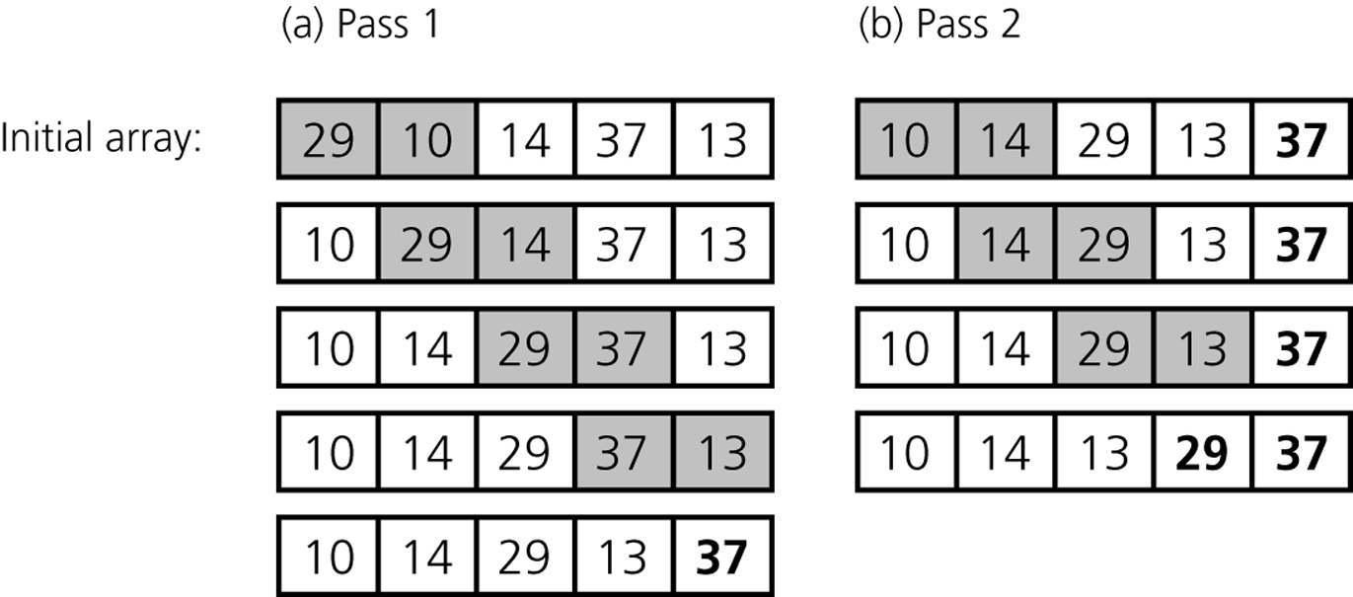
Bubble Sort
Bubble sort
Compare adjacent elements and exchange them if they are out of order
Comparing the first two elements, the second and third elements, and so on, will move the largest (or smallest) elements to the end of the array
Repeating this process will eventually sort the array into ascending (or descending) order
After first pass, largest item “bubbles” to its correct location

Slide 37
Bubble Sort: Algorithm
public static <T extends Comparable<? super T>>
void bubbleSort(T[] a, int n) {
for(int pass = 1; pass < n ; ++pass) {
for(int index = 0; index < n-pass; ++index) {
int nextIndex = index + 1;
if(a[index].compareTo(a[nextIndex]) > 0) {
T temp = a[index];
a[index] = a[nextIndex];
a[nextIndex] = temp;
}
}
}
}
public static void main(String [] args) {
Integer [] a = { 15, 8 , 10 , 2, 5 };
bubbleSort(a, a.length);
System.out.println("a = " + Arrays.toString(a));
}
Output:
a = [2, 5, 8, 10, 15]

Slide 38
Bubble Sort: Analysis
What is the worst input to the algorithm?
Array that is in reverse order
 | Cost | Times
 | c1 | n-1
 | c2 | (n-1)+(n-2) + ...+ 1
 | c3 | (n-1)+ (n-2)+ ...+ 1
 | c4 | (n-1)+ (n-2)+ ...+ 1
 | c5 | (n-1)+ (n-2)+ ...+ 1
 | c6 | (n-1)+ (n-2)+ ...+ 1
 | c7 | (n-1)+ (n-2)+ ...+ 1
 | 0 | 0
 | 0 | 0
 | 0 | 0
 | 0 | 0
public static <T extends Comparable<? super T>>
void bubbleSort(T[] a, int n) {
for(int pass = 1; pass < n ; ++pass) {
for(int index = 0; index < n-pass; ++index) {
int nextIndex = index + 1;
if(a[index].compareTo(a[nextIndex]) > 0) {
T temp = a[index];
a[index] = a[nextIndex];
a[nextIndex] = temp;
}
}
}
}
Running time= c1(n-1) + c2(n-1)n/2 + c3(n-1)(n)/2 + c4(n-1)(n)/2 + c5(n-1)(n)/2 + c6(n-1)(n)/2 + c7(n-1)(n)/2
Running time is O(n²)

Slide 39
Bubble Sort: Best-case Analysis
What is the best input to the algorithm?
Array that is already sorted
 | Cost | Times
 | c1 | n-1
 | c2 | (n-2)+(n-3) + ...+ 1
 | c3 | (n-2)+ (n-3)+ ...+ 1
 | c4 | (n-2)+ (n-3)+ ...+ 1
 | c5 | 0
 | c6 | 0
 | c7 | 0
 | 0 | 0
 | 0 | 0
 | 0 | 0
 | 0 | 0
public static <T extends Comparable<? super T>>
void bubbleSort(T[] a, int n) {
for(int pass = 1; pass < n ; ++pass) {
for(int index = 0; index < n-pass; ++index) {
int nextIndex = index + 1;
if(a[index].compareTo(a[nextIndex]) > 0) {
T temp = a[index];
a[index] = a[nextIndex];
a[nextIndex] = temp;
}
}
}
}
Best running time= c1(n-1) + c2(n-2)(n-1)/2 + c3(n-2)(n-1)/2 + c4(n-2)(n-1)/2
Best running time is O(n²)
Can we improve best running time?

Slide 40
Bubble Sort: Enhanced Algorithm
public static <T extends Comparable<? super T>>
void bubbleSort2(T[] a, int n) {
boolean sorted = false;
for(int pass = 1; pass < n && !sorted ; ++pass) {
sorted = true;
for(int index = 0; index < n-pass; ++index) {
int nextIndex = index + 1;
if(a[index].compareTo(a[nextIndex]) > 0) {
T temp = a[index];
a[index] = a[nextIndex];
a[nextIndex] = temp;
sorted = false;
}
}
}
}
Does this solution improve the worst-case complexity of algorithm?
No, it is still O(n²).
Best case is O(n). In practice, we can use this version for better
performance BUT we have to remember the worst case complexity is
unchanged

Slide 41
Bubble Sort: Best Case Analysis
What is the best input to the algorithm?
Array that is already sorted
 | Cost | Times
 | c1 | 1
 | c2 | 1
 | c3 | 1
 | c4 | n-2
 | c5 | n-2
 | c6 | n-2
 | c7 | 0
 | c8 | 0
 | c9 | 0
 | c10 | 0
 | 0 | 0
public static <T extends Comparable<? super T>>
void bubbleSort2(T[] a, int n) {
boolean sorted = false;
for(int pass = 1; pass < n && !sorted ; ++pass) {
sorted = true;
for(int index = 0; index < n-pass; ++index) {
int nextIndex = index + 1;
if(a[index].compareTo(a[nextIndex]) > 0) {
T temp = a[index];
a[index] = a[nextIndex];
a[nextIndex] = temp;
sorted = false;
}
}
}
}
Best running time= c1 + c2 + c3 + c4(n-2) + c5(n-2) + c6(n-2)
Best running time is O(n)

Slide 42
Bubble Sort
Analysis
Worst case: O(n²)
Best case: O(n)

Slide 43
Summary
Worst-case and average-case analyses
Worst-case analysis considers the maximum amount of work an algorithm requires on a problem of a given size
Average-case analysis considers the expected amount of work an algorithm requires on a problem of a given size
Order-of-magnitude analysis can be used to choose an implementation for an abstract data type
Selection sort, bubble sort, and insertion sort are all O(n²) algorithms

